Slide 1
05 – Variables

Slide 2
Questions: Conditional Execution
What is the result of (txtFah.value is 50): (txtFah.value >= 40)
What will txtTax be after the following code has executed (txtSalary.value is 4589): if (txtSalary.value < 5035){ txtTax.value = 0; }else{ txtTax.value = txtSalary.value * 0.20; }
true
0

Slide 3
Coursework 1: Plagiarism
Cannot share code
Cannot share writing
Copying code = 0% = fail ☹
Supplying code (giving to others) = 0%
Detection Very Likely (automated software)

Slide 4
Coursework 1: Plagiarism
Self-plagiarism – you may only submit a piece of work for one assessment
Getting others to do work for you:
You can be asked at any time to explain your work
If you cannot explain your work, you may be found guilty of plagiarism
Lecture material:
can be used freely (and adapted) for assignments

Slide 5
Session Aims & Objectives
Aims
Introduce you to (invisible) data storage concepts, i.e. variables
Objectives, by end of this week’s sessions, you should be able to:
declare a variable
assign a value to a variable,
using combination of literal values, operators, functions, and identifiers
determine whether a variable is in or out of scope at a given point in a piece of code
select a variable’s scope in your own program

Slide 6
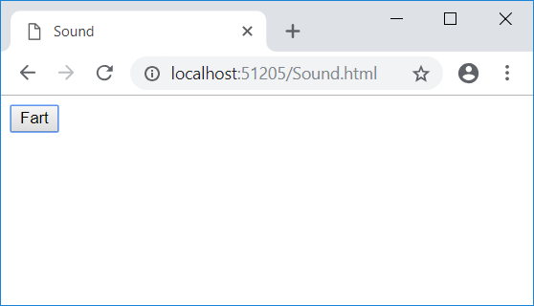
Example: Sound
<html>
<head><title>Sound</title></head>
<body>
<input id="btnFart" type="button" value="Fart" onclick="btnFart_onClick()" />
<audio id="sndPlayer" src="fart.wav"></audio>
</body>
</html>
<script>
function btnFart_onClick(){
sndPlayer.play();
}
</script>

Slide 7
Example: GuessNum – Analysis
SPECIFICATION
User Requirements
need to keep children occupied/entertained, while learning about maths
Software Requirements
Functional:
computer picks a number between 0 and 10
user enters a number
compare numbers and display appropriate message
Non-functional should be easy and fun to use

Slide 8
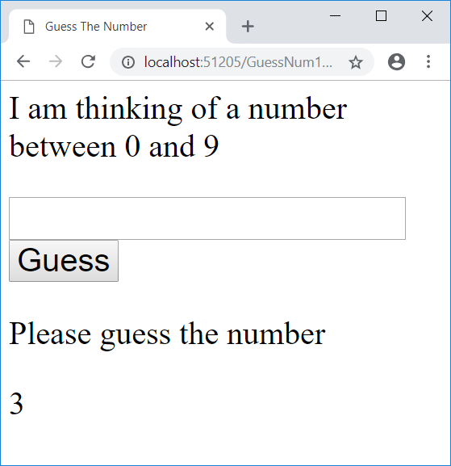
Example: GuessNum - Code
Generate Random Number
between 0 and 9
<script>
function window_onLoad(){
parNum.innerText = parseInt(Math.random() * 10);
}
function btnGuess_onClick(){
if(parseInt(txtGuessNum.value) == parseInt(parNum.innerText)){
parResult.innerText = "Correct";
}else{
parResult.innerText = "Wrong, please try again";
}
}
</script>
Check user's answer against correct answer

Slide 9
Variables (why?)
Variables useful for:
storing information you don't want user to see
reducing memory use
speed up execution
storing intermediate results of calculations temporarily:
makes code easier to understand, &
prevents need to re-calculate
making code easier to read (short variable name instead of long object.property names)

Slide 10
Variables (what)
Variables have
Identifier (name) – you choose this, used to refer to (reference) variable
Value – you set/change this
x
23
Name/Identifier
Value
Memory

Slide 11
Variable declaration (how)
Variables must be declared, using the following syntax (grammar): var identifier; e.g. var weight; var x; var s; var year;
represents the name of the variable

Slide 12
Questions: Variable declaration
Write a line of code that:
Declares a variable called a
Declares a variable called y
Declares a variable called surname
var a;
var y;
var surname;

Slide 13
Variable assignment (how)
Variables are assigned values, using the following syntax: identifier = expression e.g. x = 5; weight = 109.45; name = "Bob"; s = "Hello "; Note: the data flows backwards (from right to left) read the = as 'becomes equal to'

Slide 14
Questions: Variable assignment
Write a line of code that:
Assigns the value of 23 to the variable y
Puts 14.6 into a variable called x
Assigns the value of ‘John’ to the variable surname
y = 23;
x = 14.6;
surname = "John";

Slide 15
Variables: Numeric Data

Slide 16
Variables: Dry running
list the values of variables as each line is run:
 | num1 | num2
var num1;
var num2;
num1 = 8;
num2 = num1;
num1 = 3;
num2 = 2 + num1;
-
-
-
-
8
-
8
8
3
8
3
5

Slide 17
Variables: String Data

Slide 18
Questions: Dry running
Produce a dry run table for the following code:
 | d | f
var d;
var f;
f = 3;
d = f + 2;
d = d + 4;
-
-
-
-
-
3
5
3
9
3

Slide 19
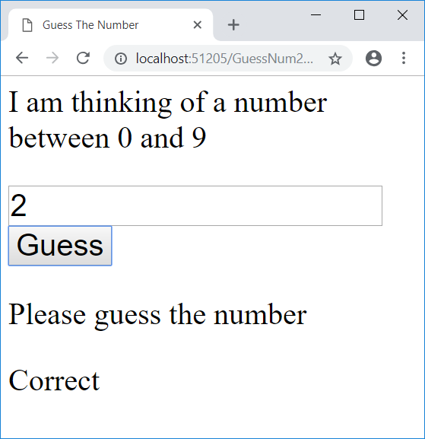
Example: GuessNum - Code
Create variable
<script>
var GuessNum;
function window_onLoad(){
GuessNum = parseInt(Math.random() * 10);
}
function btnGuess_onClick(){
if(parseInt(txtGuessNum.value) == GuessNum){
parResult.innerText = "Correct";
}else{
parResult.innerText = "Wrong, please try again";
}
}
</script>
Put Random Number
into variable
Use (Read)
variable

Slide 20
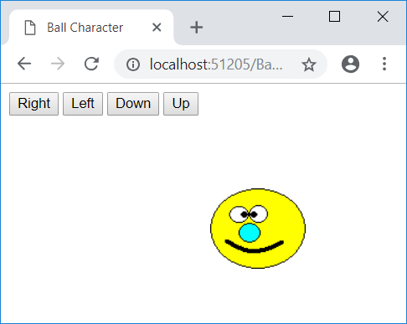
Example: Ball Character (design)
WHEN Right button Clicked
move ball character right
WHEN Left button Clicked
move ball character left
WHEN Up button Clicked
move ball character up
WHEN Down button Clicked
move ball character down

Slide 21

Absolute Positioning
picBall.style.top
picBall.style.left
picBall.height
picBall.width
document.body.clientWidth
change properties – change position

Slide 22
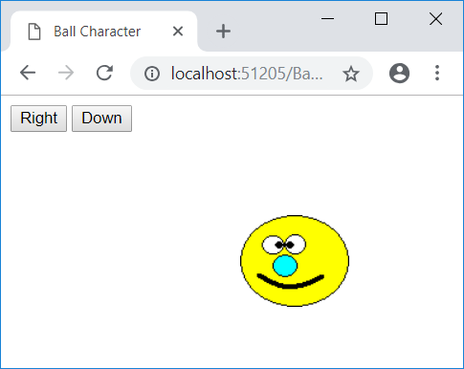
Example: Ball Character v0
<html>
<head><title>Ball Character</title></head>
<body onload="window_onLoad()">
<input id="btnRight" type="button" value="Right"
onclick="btnRight_onClick()" />
<input id="btnDown" type="button" value="Down" />
<img id="picBall" src="BallChar.gif" style="position: absolute;" />
</body>
</html>
<script>
function window_onLoad(){
picBall.style.left = "200px";
picBall.style.top = "100px";
}
function btnRight_onClick(){
picBall.style.left = picBall.style.left + 10; // Does not work!
}
</script>
window_onload (works – as page loads)
Does not work: Cannot add 10 to "200px"

Slide 23
Example: Ball Character v1
<html>
<head><title>Ball Character</title></head>
<body onload="window_onLoad()">
<input id="btnRight" type="button" value="Right"
onclick="btnRight_onClick()" />
<input id="btnDown" type="button" value="Down" />
<img id="picBall" src="BallChar.gif" style="position: absolute" />
</body>
</html>
<script>
var x;
function window_onLoad(){
x = 200;
picBall.style.left = x + "px";
picBall.style.top = "100px";
}
function btnRight_onClick(){
x = x + 10;
picBall.style.left = x + "px";
}
</script>
Solution: use a variable

Slide 24
Example: Ball Character v2
<html>
<head><title>Ball Character</title></head>
<body onload="window_onLoad()">
<input id="btnRight" type="button" value="Right"
onclick="btnRight_onClick()" />
<input id="btnDown" type="button" value="Down" />
<img id="picBall" src="BallChar.gif" style="position: absolute" />
</body>
</html>
<script>
var x;
function window_onLoad(){
x = 200;
picBall.style.left = x + "px";
picBall.style.top = "100px";
}
function btnRight_onClick(){
x = x + 10;
picBall.style.left = x + "px";
}
</script>
1. Add buttons
2. Write code to: WHEN Left button Clicked
move ball character left
WHEN Up button Clicked
move ball character up

Slide 25
Example: Ball Char (v3)
Functional Decomposition
Incremental Development
Get ball char to move automatically:
get ball char to appear on left of page✓
get ball char to move right on page (user click)✓
get ball char to move right on page automatically

Slide 26
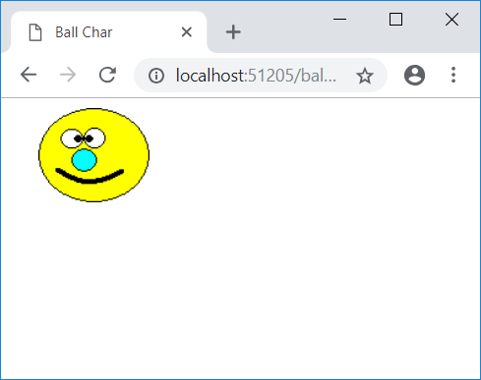
Example: Ball Char (v3)
<html>
<head><title>Ball Char</title></head>
<body onload="window_onLoad()">
<img id="picBall" src="BallChar.gif" style="position: absolute;" />
</body>
</html>
<script>
var x;
function window_onLoad(){
x = 0;
window.setInterval("MoveBall()", 250);
}
function MoveBall(){
x = x + 10;
picBall.style.left = x + "px";
}
</script>
Interval (in milliseconds: 1000 = 1s)

Slide 27
Example: Ball Char
Functional Decomposition
Incremental Development
Get ball char to bounce horizontally:
get ball char to appear on left of page ✓
get ball char to move right on page (user click) ✓
get ball char to move right on page automatically ✓
get ball char to stop at end
get ball char to change direction

Slide 28
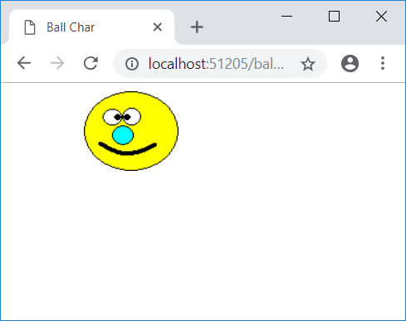
Example: Ball Char (v4)
<script>
var x;
function window_onLoad(){
x = 0;
window.setInterval("MoveBall()", 250);
}
function MoveBall(){
x = x + 10;
if(x < document.body.clientWidth){
picBall.style.left = x + "px";
}
}
</script>
Only move if inside client area

Slide 29
Example: Moon Orbit – Analysis
SPECIFICATION
User Requirements
need to keep children occupied/entertained, while learning about the moon's orbit
Software Requirements
Functional:
Orbit of moon around earth should be animated
Children should be able to control speed and direction
Non-functional should be easy and fun to use

Slide 30
Problem solving: Pseudo-code
To solve problem
think about how you would solve it manually (without computer)
think of steps you would take
Moon position
increase angle
move moon
horizontal position
vertical position
Convert to code
1
2
3

Slide 31
Trigonometry: In general
angle (ang)
hypotenuse (H)
adjacent (A) =
Cos(ang) * H
opposite (O) =
Sin(ang) * H

Slide 32


Trigonometry: Moon Orbit
angle (ang)
Cos(ang) * 150
150
Sin(ang) * 150

Slide 33
Trigonometry: Radians
Radians used by computers instead of degrees:
180 deg (3.1 rad)
π
π/2
(4.65 rad) 270 deg
90 deg (1.55 rad)
0 or 360 deg (0 or 6.2 rad)
rad = (deg/180) * 3.1

Slide 34
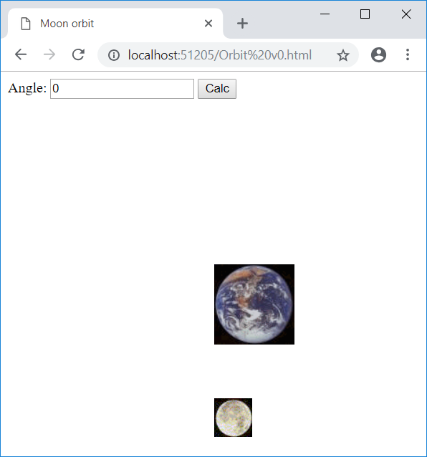
Example: Moon Orbit v1
<html>
<head><title>Moon orbit</title></head>
<body onload="window_onLoad()">
Angle: <input id="txtAngle" type="text" />
<input id="btnCalc" type="button" value="Calc" onclick="btnCalc_onClick()" />
<img id="imgEarth" src="Earth.gif" style="position: absolute" />
<img id="imgMoon" src="Moon.gif" style="position: absolute" />
</body>
</html>
<script>
var xEarth;
var yEarth;
function window_onLoad(){
xEarth = document.body.clientWidth / 2;
yEarth = document.body.clientHeight / 2;
imgEarth.style.left = xEarth;
imgEarth.style.top = yEarth;
imgMoon.style.left = xEarth;
imgMoon.style.top = yEarth + 150;
txtAngle.value = 0;
}
function btnCalc_onClick(){
imgMoon.style.left = xEarth + (Math.sin(txtAngle.value) * 150);
imgMoon.style.top = yEarth + (Math.cos(txtAngle.value) * 150);
}
</script>
1
2
3

Slide 35
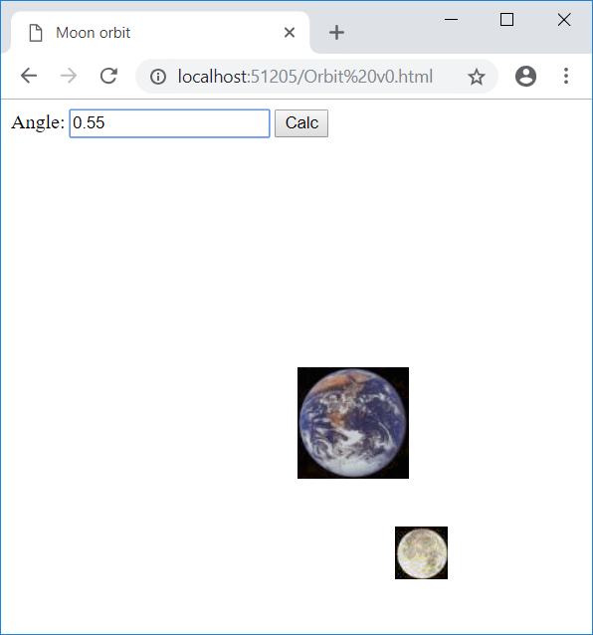
Example: Moon Orbit v1
Use:
setInterval
change angle
move moon’s horizontal
move moon’s vertical

Slide 36
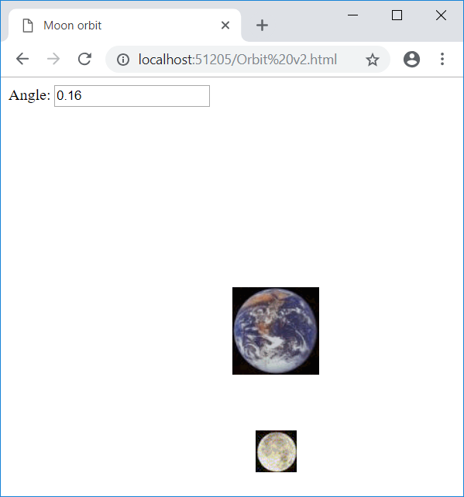
Example: Moon Orbit v2
<html>
<head><title>Moon orbit</title></head>
<body onload="window_onLoad()">
Angle: <input id="txtAngle" type="text" />
<img id="imgEarth" src="Earth.gif" style="position: absolute" />
<img id="imgMoon" src="Moon.gif" style="position: absolute" />
</body>
</html>
<script>
var xEarth;
var yEarth;
function window_onLoad(){
xEarth = document.body.clientWidth / 2;
yEarth = document.body.clientHeight / 2;
imgEarth.style.left = xEarth;
imgEarth.style.top = yEarth;
imgMoon.style.left = xEarth;
imgMoon.style.top = yEarth + 150;
txtAngle.value = 0;
window.setInterval("MoveMoon()", 50);
}
function MoveMoon(){
txtAngle.value = parseFloat(txtAngle.value) + 0.01;
imgMoon.style.left = xEarth + (Math.sin(txtAngle.value) * 150);
imgMoon.style.top = yEarth + (Math.cos(txtAngle.value) * 150);
}
</script>

Slide 37
Problem: Intermediate Results
<html>
<head><title>Moon orbit</title></head>
<body onload="window_onLoad()">
Angle: <input id="txtAngle" type="text" />
<img id="imgEarth" src="Earth.gif" style="position: absolute" />
<img id="imgMoon" src="Moon.gif" style="position: absolute" />
</body>
</html>
<script>
var xEarth;
var yEarth;
function window_onLoad(){
xEarth = document.body.clientWidth / 2;
yEarth = document.body.clientHeight / 2;
imgEarth.style.left = xEarth;
imgEarth.style.top = yEarth;
imgMoon.style.left = xEarth;
imgMoon.style.top = yEarth + 150;
txtAngle.value = 0;
window.setInterval("MoveMoon()", 50);
}
function MoveMoon(){
txtAngle.value = parseFloat(txtAngle.value) + 0.01;
imgMoon.style.left = xEarth + (Math.sin(txtAngle.value) * 150);
imgMoon.style.top = yEarth + (Math.cos(txtAngle.value) * 150);
}
</script>
Intermediate result stored in object (txtAngle.value)
visible
takes lot of memory
slow
verbose

Slide 38
Solution: Variables (v3)
<html>
<head><title>Moon orbit</title></head>
<body onload="window_onLoad()">
<img id="imgEarth" src="Earth.gif" style="position: absolute" />
<img id="imgMoon" src="Moon.gif" style="position: absolute" />
</body>
</html>
<script>
var xEarth;
var yEarth;
var angle;
function window_onLoad(){
xEarth = document.body.clientWidth / 2;
yEarth = document.body.clientHeight / 2;
imgEarth.style.left = xEarth;
imgEarth.style.top = yEarth;
imgMoon.style.left = xEarth;
imgMoon.style.top = yEarth + 150;
angle = 0;
window.setInterval("MoveMoon()", 50);
}
function MoveMoon(){
angle = angle + 0.01;
imgMoon.style.left = xEarth + (Math.sin(angle) * 150);
imgMoon.style.top = yEarth + (Math.cos(angle) * 150);
}
</script>
Remove object
shorter code
invisible to user
memory efficient
faster execution
Declaration of Variable
initial value
change value
Use of Variable

Slide 39
Variables: Name redefined
<script>
var x;
var y;
var x;
x = 23;
y = 10;
23 = x;
</script>
can't use same name again

Slide 40
Variables: Expected statement
<script>
var x;
var y;
x = 23;
y = 10;
23 = x;
</script>
destination can't be literal

Slide 41
Questions: Variable assignment 2
Write a line of code that:
Increases the value of x by 2.89
Divides Miles by 1.6 and puts the result in Km
x = x + 2.89;
Km = Miles / 1.6;

Slide 42
Variables: Errors
var z;
function window_onClick(){
var s;
var x;
var x;
y = 5;
z = 5;
}
OK
OK
OK
OK
Duplicate definition
Variable not defined
OK, as z is page level

Slide 43
Variable Scope (what)
Scope – accessibility/visibility
Local (declared within procedure)
Page (general declarations)

Slide 44
Variable Scope (How)
var mv;
function btnCalc_onClick(){
var lv1;
...
}
function btnAdd_onClick(){
var lv2;
...
}
Page variables
general declarations (top)
Local variables:
in procedures

Slide 45
Variables: Scope (How)

Slide 46
Variable Scope (why)
In short – Robustness of code/software
Protection from accidental outside interference
One of many responses to code that is
Difficult to maintain, and
Unreliable
House of cards phenomenon
Prevent:
Uncontrolled and ad hoc interactions between code
Always define things at lowest level needed

Slide 47
Variable Scope Errors
Spot the error in the following:
function btnCalc_onClick(){
var x;
x = 0;
parTotal.innerText = "£" + x;
}
function btnQuit_onClick(){
x = 0;
parTotal.innerText = "£" + x;
}
Variable not defined

Slide 48
Question: Variable Scope
Will this compile?
var v;
var x;
…
function window_onLoad(){
var z;
x = 23;
y = "there";
z = 12;
}
function btnTest_onClick(){
var y;
y = "hello";
x = 67;
z = 53;
}
Is x in scope?
Is y in scope?
Is z in scope?
Yes
No
Yes
Is y in scope?
Is x in scope?
Is z in scope?
Yes
Yes
No

Slide 49
Variable Names
Variables in same scope cannot have same name:

Slide 50
Tutorial Exercises: Guess Num
LEARNING OBJECTIVE: use variables to simplify and make code more dynamic
Task 1: Get GuessNum example working. You will need to create the html for the text box, button, and labels.
Task 2: Modify GuessNum to tell the user whether their incorrect guess was higher of lower than the correct number.
Task 3: Modify GuessNum to only allow 5 attempts before picking a new number.

Slide 51
Tutorial Exercise: Ball Char
LEARNING OBJECTIVE: to understand objects, events, properties, and event handler procedures, so that you can create dynamic content in your web-pages
TASK 1: Get the Right button from the Ball Character example working. (code provided, images in resources area on server).
TASK 2: Get the Left, Down, and Up buttons working. (You will need to work out what code to use. Use the code provided as inspiration)
TASK 3: Make the Ball Character blink when the user moves the mouse over it. (add code that changes the picture – like the Puppy example)
TASK 4: Add a button to move the Ball Character diagonally. (You will need two lines of code in the same event handler)

Slide 52
Tutorial Exercises: Ball Char
LEARNING OBJECTIVE: to assign a value to a object's property,
using combination of literal values, operators, functions, and identifiers
Task 5: get the ball char (v2) example working
Task 6: add a button that resets the ball char's horizontal position to 0
Task 7: add a text box that allows the user to control the speed of the ball character. HINT: Currently, the ball char will always move 5 pixels at a time.
Task 8: add a button that stops the ball char moving. HINT: button should put 0 into the text box
Task 9: add two buttons – one for fast and one for slow
Task 10: add two more buttons – one for fast backwards and one for slow backwards
Task 11: make it bounce off both sides of the client area (screen).
Task 12: hide the speed text box HINT: this should happen when the window loads, using style.visibility
Task 13: play a sound when the ball character is clicked

Slide 53
Tutorial Exercises: Moon Orbit
LEARNING OBJECTIVE: use variables to simplify and make code more dynamic
Task 1: Get Moon Orbit examples working. The code is provided on the slides.
Task 2: Change the web page background to black. The code for this is in an earlier lecture.
Task 3: Modify your page to allow the user to stop speed up and change the moon's direction. Use the existing code as inspiration.
Task 4: Modify your page so that it makes a water noise when the mouse moves over the Earth, and the ohh noise over the moon. Use code from previous lectures as inspiration.

